Slide 1
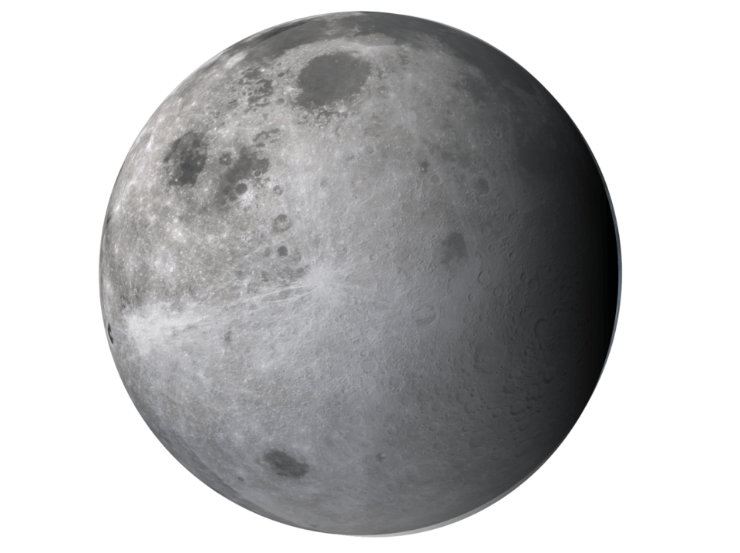
HW 7: Crater relative navigation
Cory Puckett
Notes:
Hi I’m cory
Image source: https://www.slsc.org/50-years-ago-apollo-12-on-the-moon/

Slide 2
Crater relative Navigation
Knowns
Crater Data base
Crater Image
Crater index creation
Crater Identification
Grunert’s Method
Unknowns
Camera Pose
Notes:
Crater relative nav is subcategory of terrain relative navigation
Crater index creation won’t be covered here

Slide 3
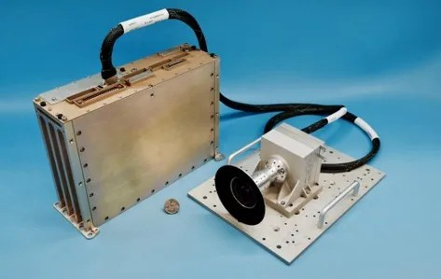
Use of Terrain Relative Navigation
Mars 2020 rover
Intuitive Machines IM-1 (Odysseus) Lander

Slide 4
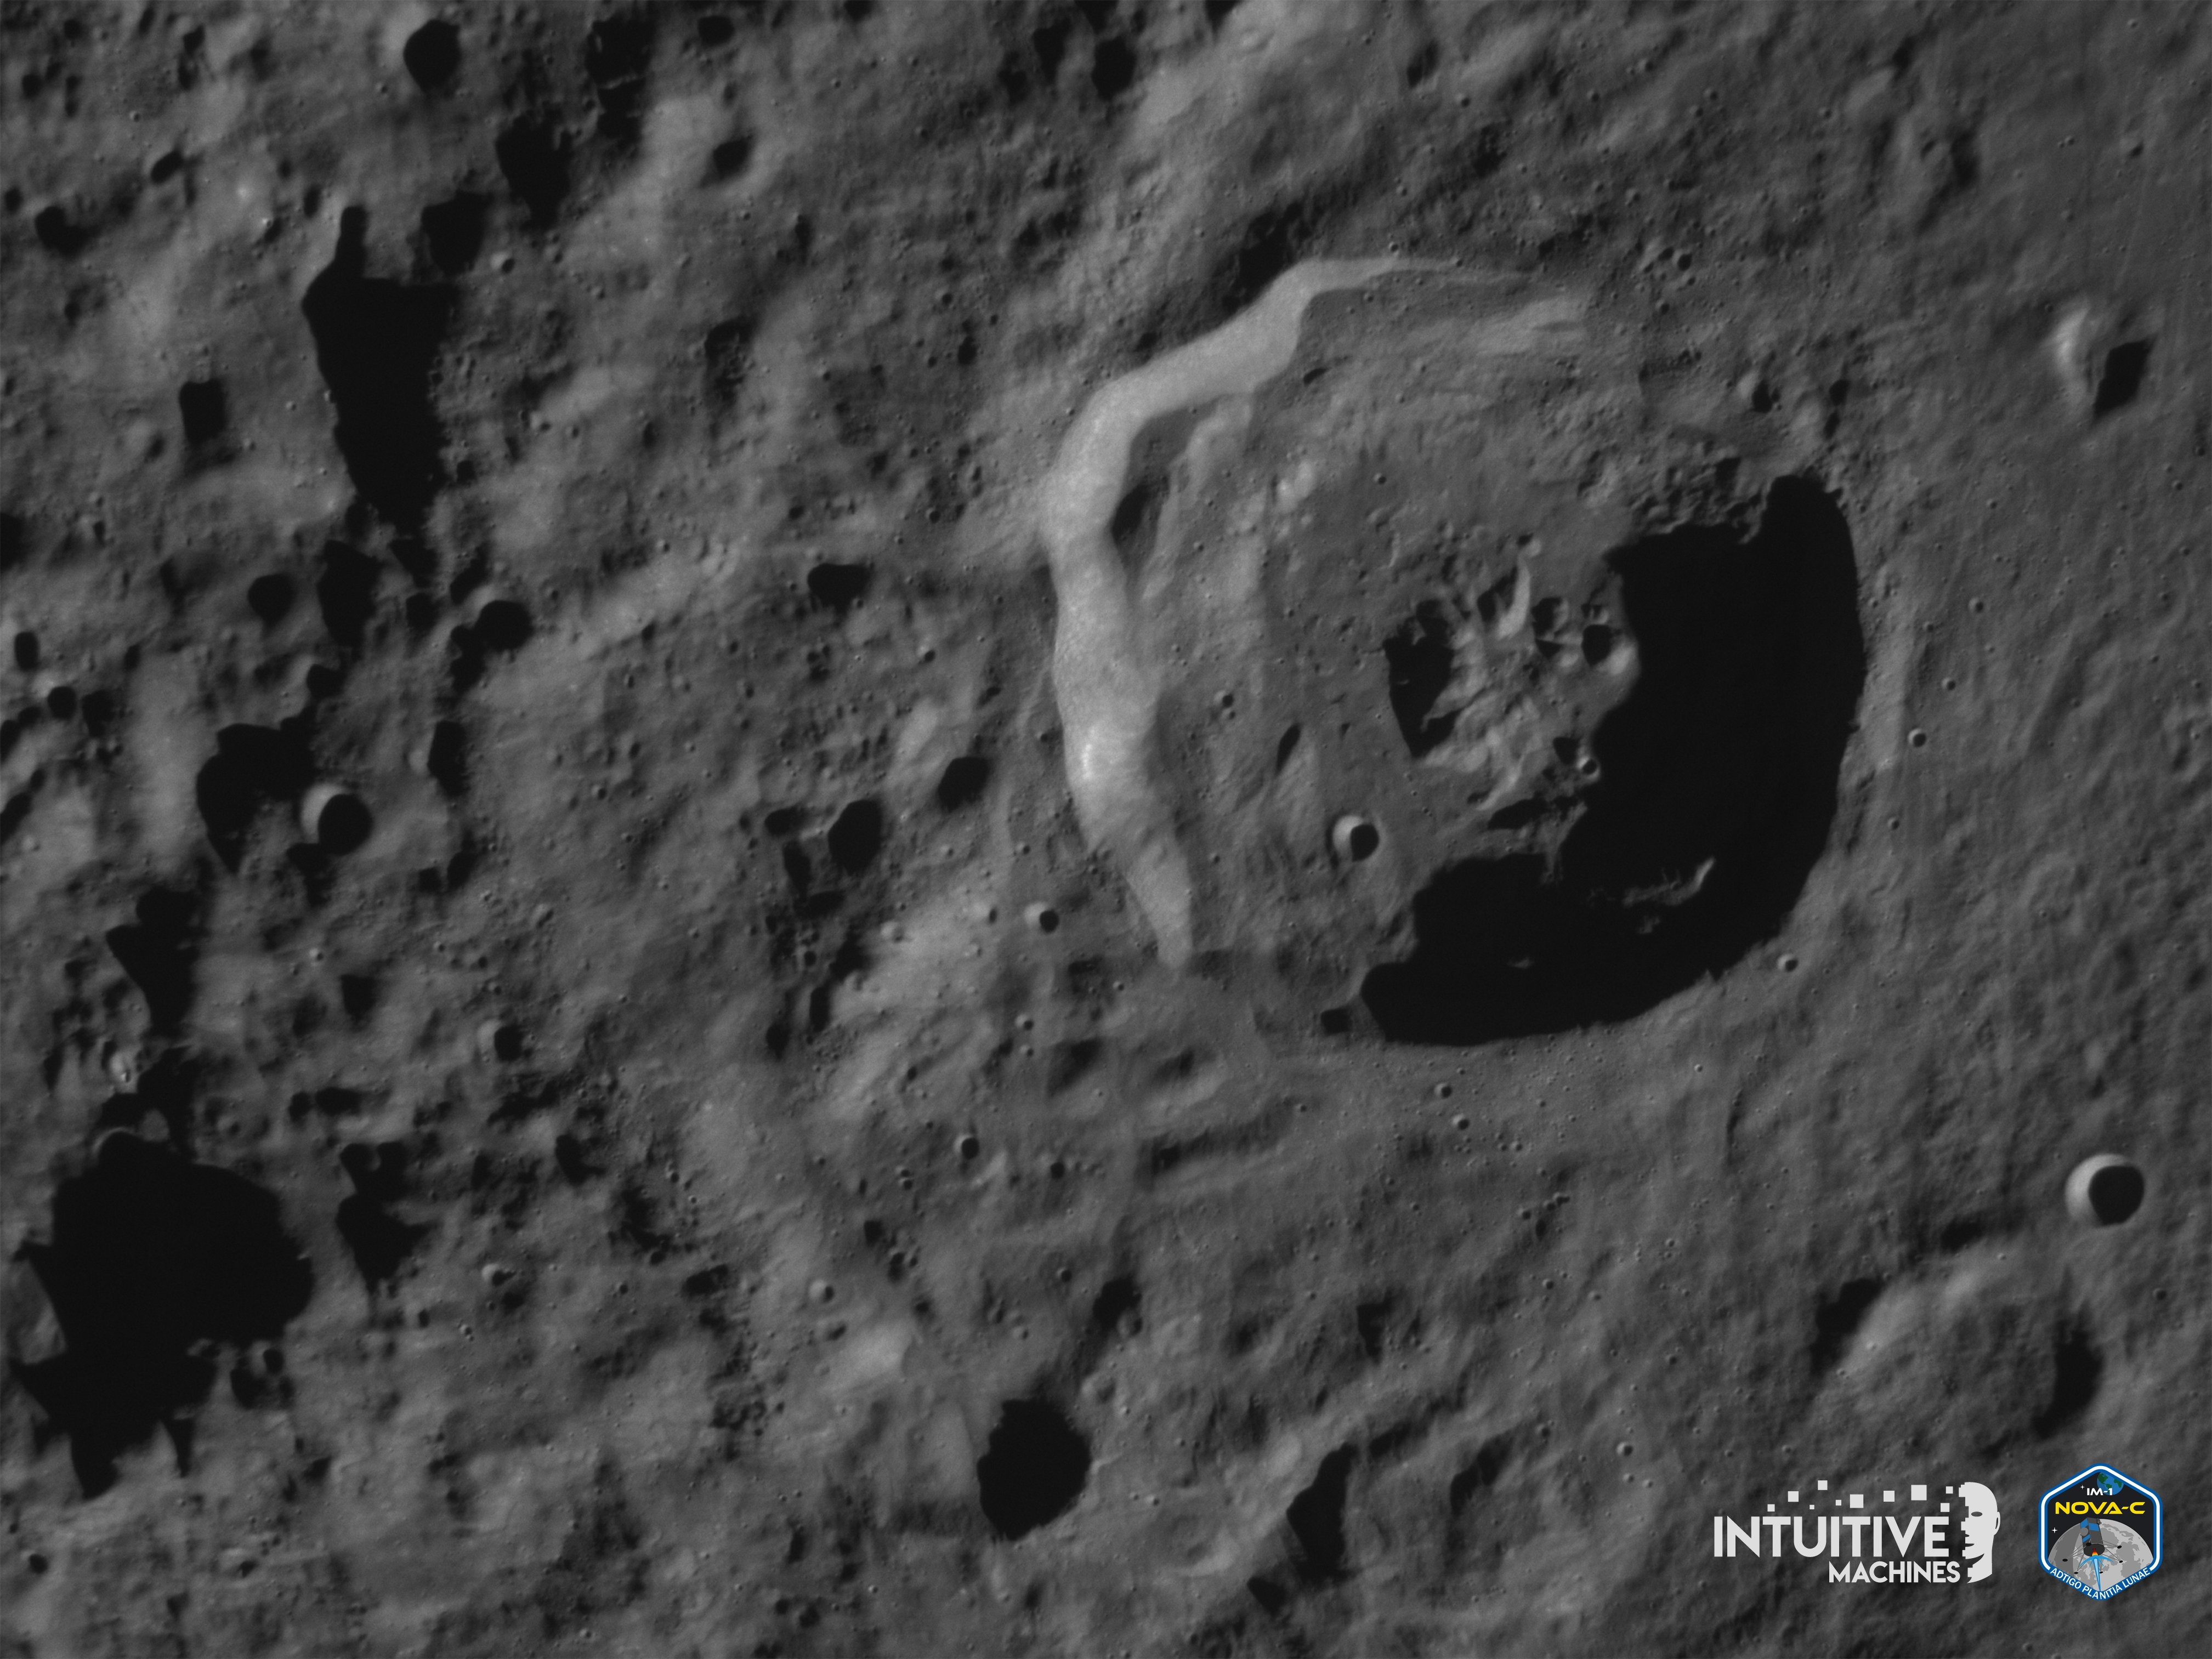
Crater relative Navigation
Intuitive machines Odysseus lander looking at Bel’kovich K crater
Notes:
Image flipped for easier interpretation. Brain normally interprets light from above so image was rotated so that light is from above and makes the craters look like craters instead of mountains.

Slide 5
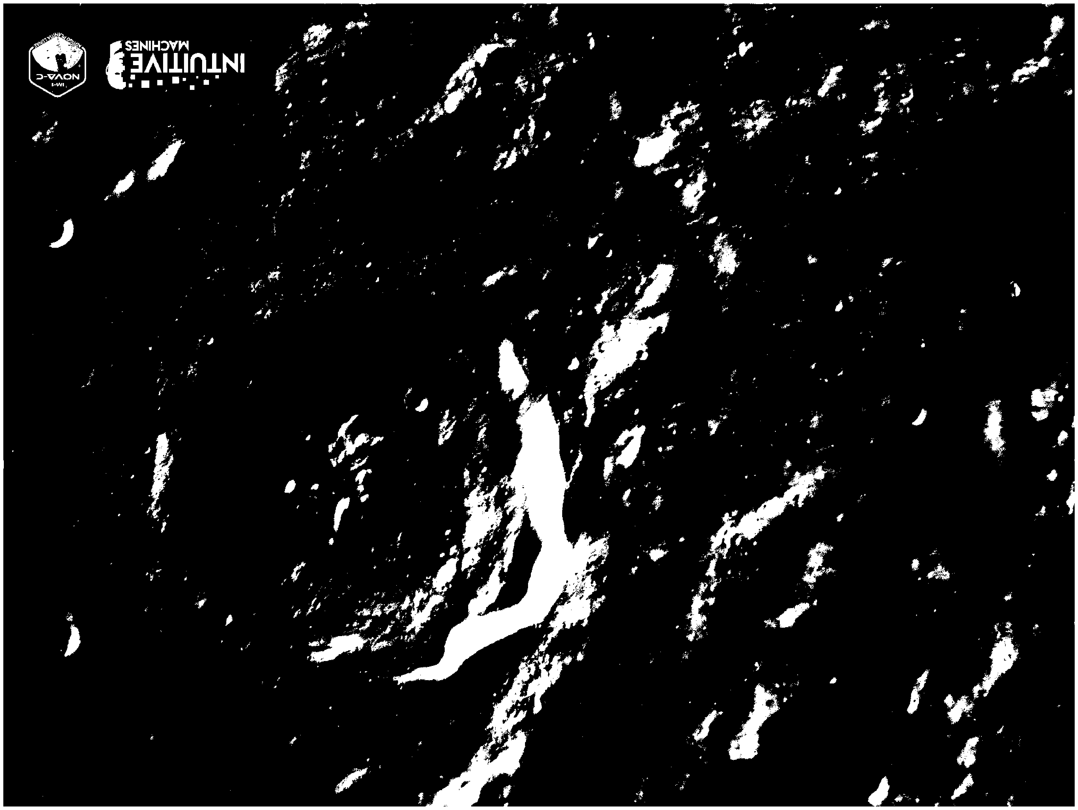
Crater identification
Can use computer vision to identify bright and dark sides of craters
These can be used to generate ellipses of craters
Notes:
Image shows bright regions of image highlighted. Bright half of some of the smaller craters are circled.

Slide 6
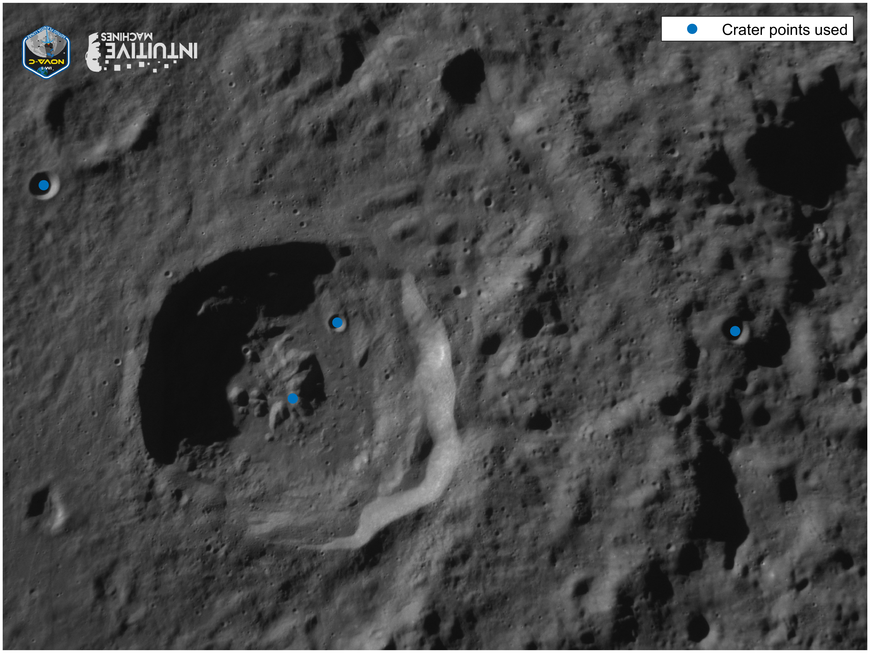
Crater identification
Craters were manually identified
4 Craters selected
Notes:
Craters were manually identified in my case.

Slide 7
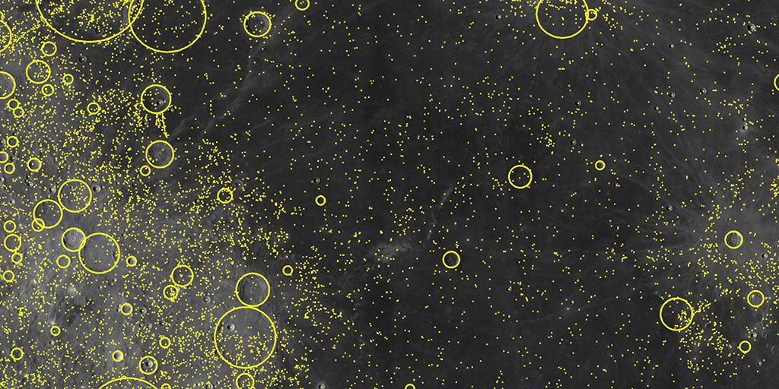
Crater Database
Robbins crater database contains latitude, longitude, and shape information for 1.2 million craters
Notes:
Image of a sampling of the craters from database website. Approximately complete from craters larger than 1-2 km in size.
Image credit: https://astrogeology.usgs.gov/search/map/Moon/Research/Craters/lunar_crater_database_robbins_2018

Slide 8
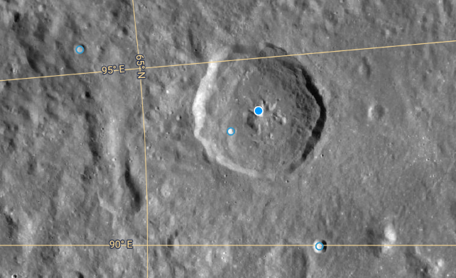
Crater Selection
Manually picked crater centers from ACT Lunar map
Lat and Long
converted to MCMF

Slide 9
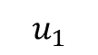
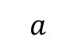
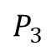

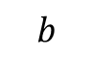
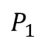
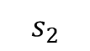

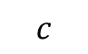

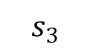
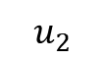
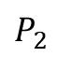
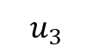
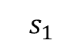
Perspective-N-Point Problem set up
Camera
$$u_{2}$$
$$u_{1}$$
$$u_{3}$$
$$s_{2}$$
$$s_{1}$$
$$s_{3}$$
$$P_{2}$$
$$Z$$
$$c$$
$$Y$$
$$P_{1}$$
$$a$$
$$X$$
$$b$$
$$P_{3}$$

Slide 10
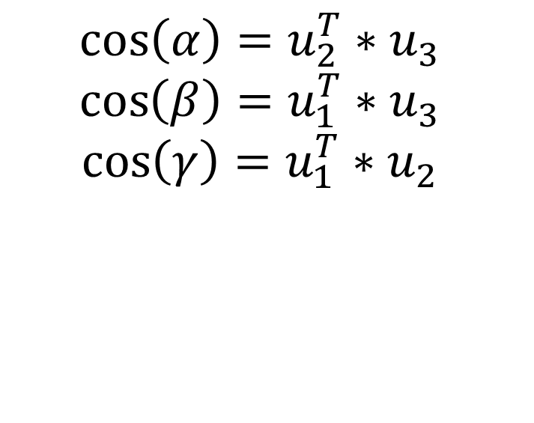
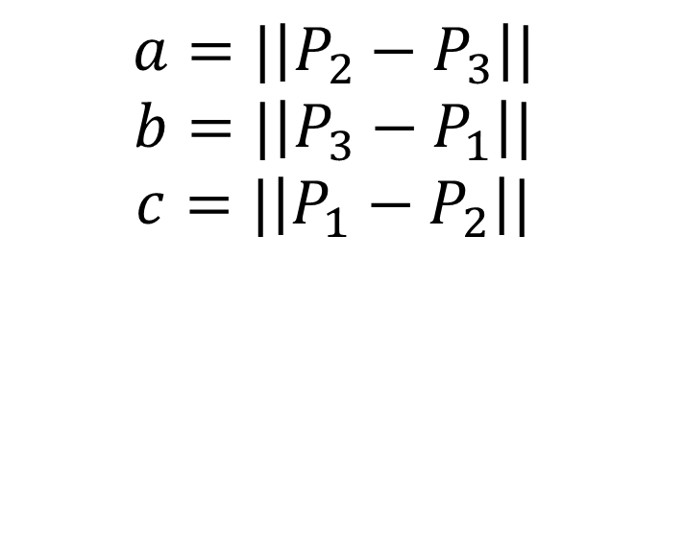
Grunert’s Method
$$a=|\left|P_{2}−P_{3}\right||$$
$$b=|\left|P_{3}−P_{1}\right||$$
$$c=|\left|P_{1}−P_{2}\right||$$
$$\cos\left(α\right)=u_{2}^{T}∗u_{3}$$
$$\cos\left(β\right)=u_{1}^{T}∗u_{3}$$
$$\cos\left(γ\right)=u_{1}^{T}∗u_{2}$$

Slide 11
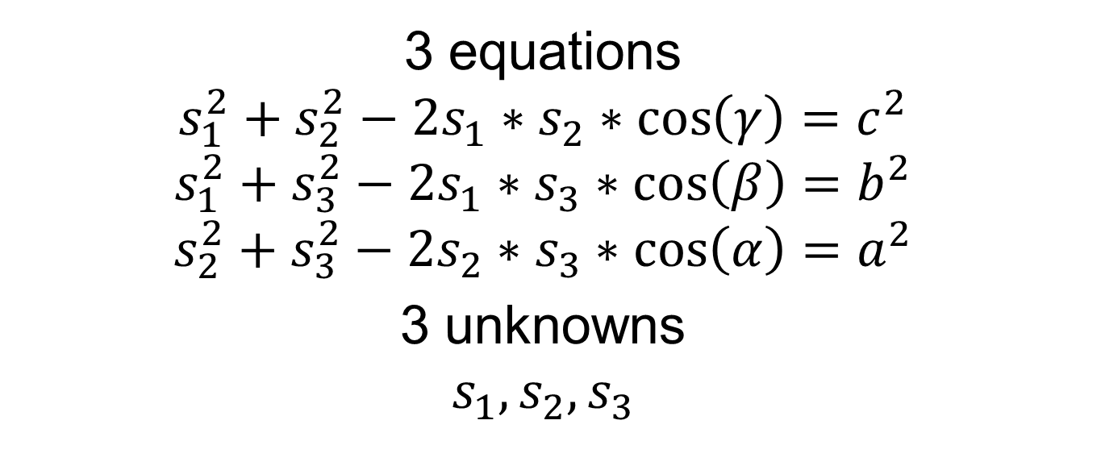
Grunert’s Method
3 equations
$$s_{1}^{2}+s_{2}^{2}−2s_{1}∗s_{2}∗\cos\left(γ\right)=c^{2}$$
$$s_{1}^{2}+s_{3}^{2}−2s_{1}∗s_{3}∗\cos\left(β\right)=b^{2}$$
$$s_{2}^{2}+s_{3}^{2}−2s_{2}∗s_{3}∗\cos\left(α\right)=a^{2}$$
3 unknowns
$$s_{1},s_{2}, s_{3}$$

Slide 12
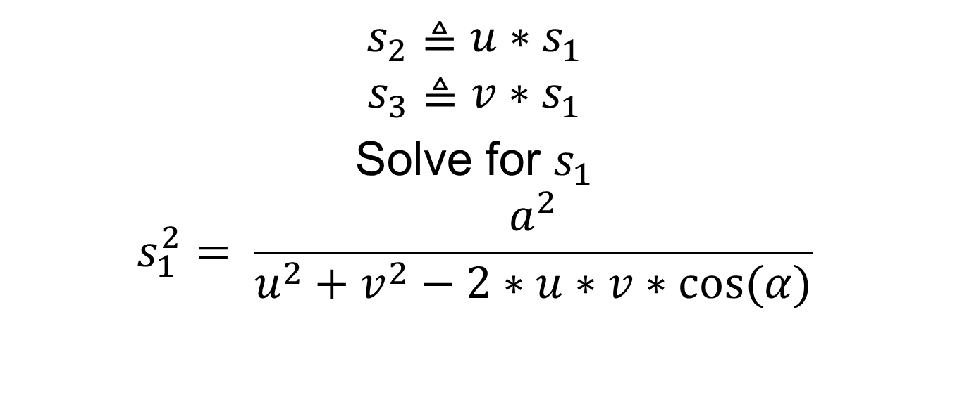
Grunert’s Method
$$s_{2}≜u∗s_{1}$$
$$s_{3}≜v∗s_{1}$$
Solve for $s_{1}$
$$s_{1}^{2}= \frac{a^{2}}{u^{2}+v^{2}−2∗u∗v∗cos⁡(α)}$$

Slide 13
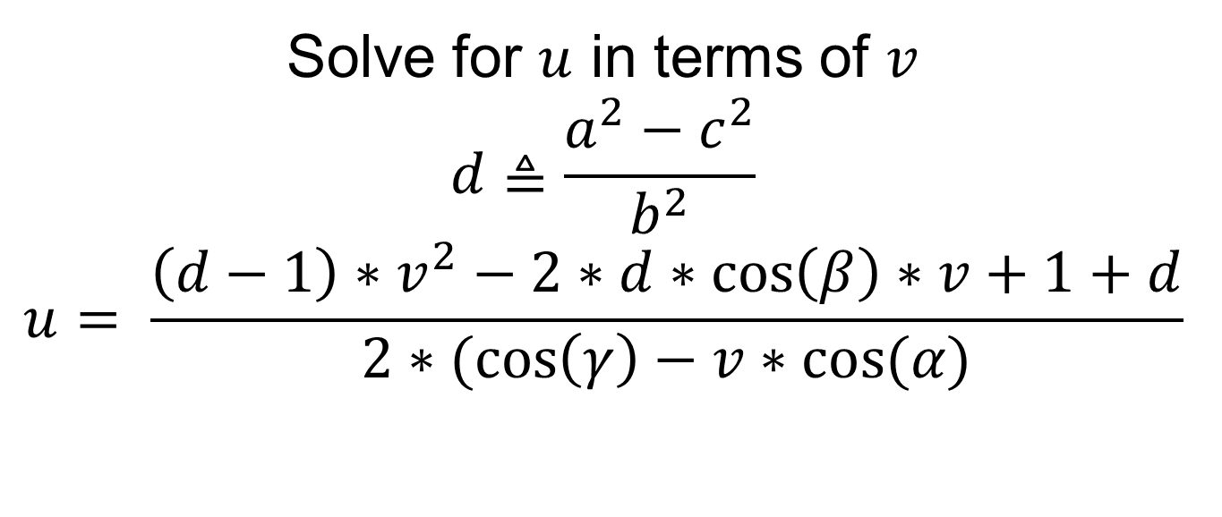
Grunert’s Method
Solve for $u$ in terms of $v$
$$d≜\frac{a^{2}−c^{2}}{b^{2}}$$
$$u= \frac{\left(d−1\right)∗v^{2}−2∗d∗\cos\left(β\right)∗v+1+d}{2∗(\cos\left(γ\right)−v∗cos⁡(α)}$$

Slide 14
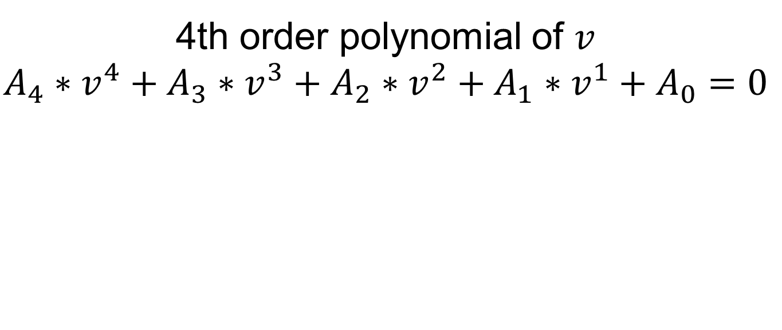
Grunert’s Method
4th order polynomial of $v$
$$A_{4}∗v^{4}+A_{3}∗v^{3}+A_{2}∗v^{2}+A_{1}∗v^{1}+A_{0}=0$$

Slide 15
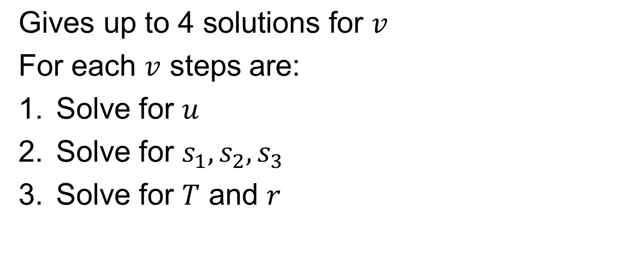
Grunert’s Method
$\text{Gives} \text{up} \text{to}\text{ 4 }\text{solutions} \text{for}$ $v$
For each $v$ steps are:
Solve for $u$
Solve for $s_{1},s_{2},s_{3}$
Solve for $T$ and $r$

Slide 16
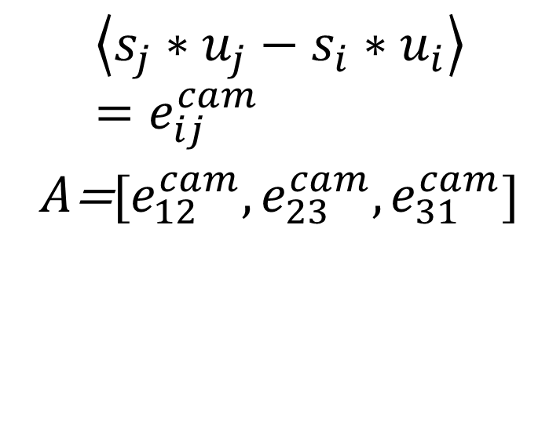
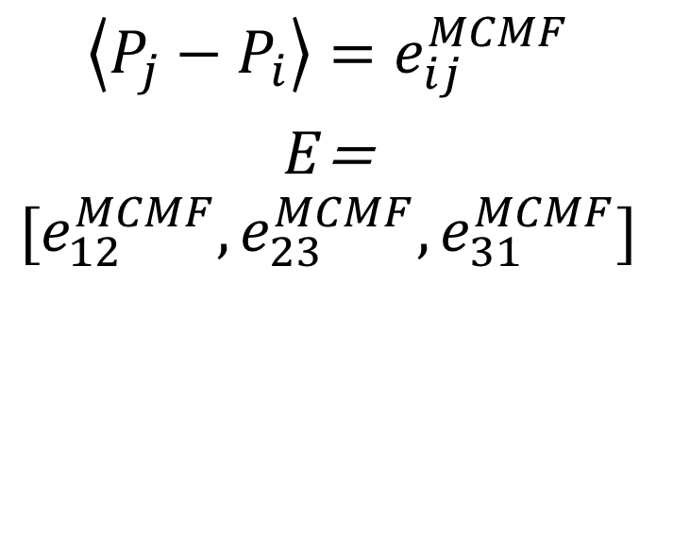
Grunert’s Method
$$\left\langle P_{j}−P_{i}\right\rangle =e_{ij}^{MCMF}$$
$E$=
$$[e_{12}^{MCMF},e_{23}^{MCMF},e_{31}^{MCMF}]$$
$$\left\langle s_{j}∗u_{j}−s_{i}∗u_{i}\right\rangle =e_{ij}^{cam}$$
$A$=$[e_{12}^{cam},e_{23}^{cam},e_{31}^{cam}]$

Slide 17
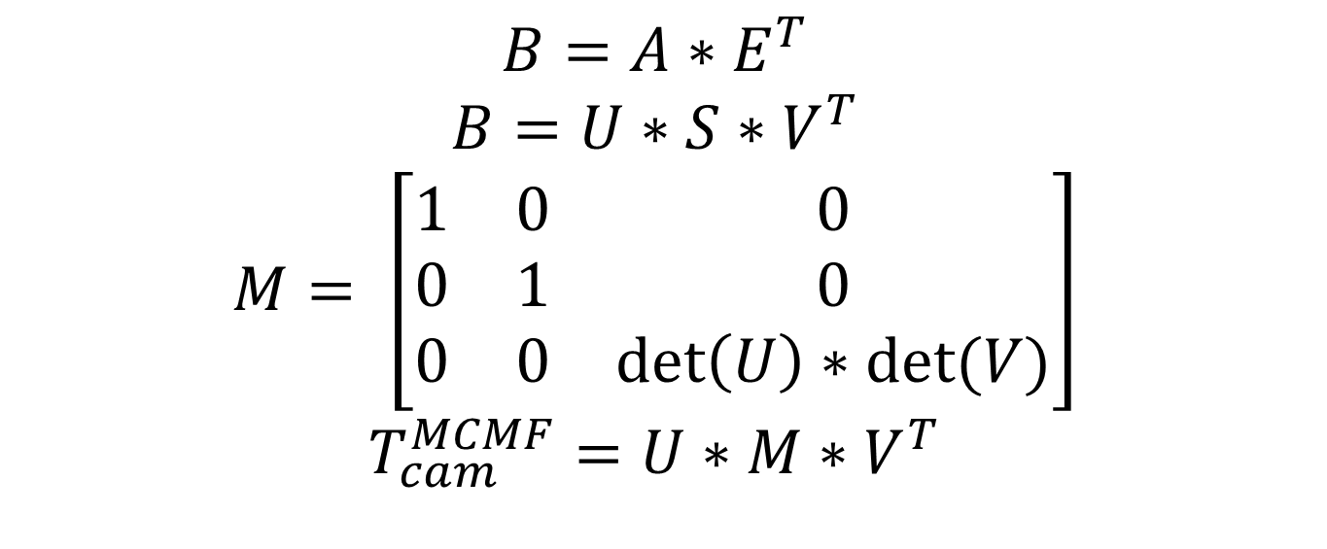
Grunert’s Method
$$B=A∗E^{T}$$
$$B=U∗S∗V^{T}$$
$$M= \left[\begin{matrix}1 & 0 & 0 \\ 0 & 1 & 0 \\ 0 & 0 & \det\left(U\right)∗det⁡(V)\end{matrix}\right]$$
$$T_{cam}^{MCMF}=U∗M∗V^{T}$$

Slide 18
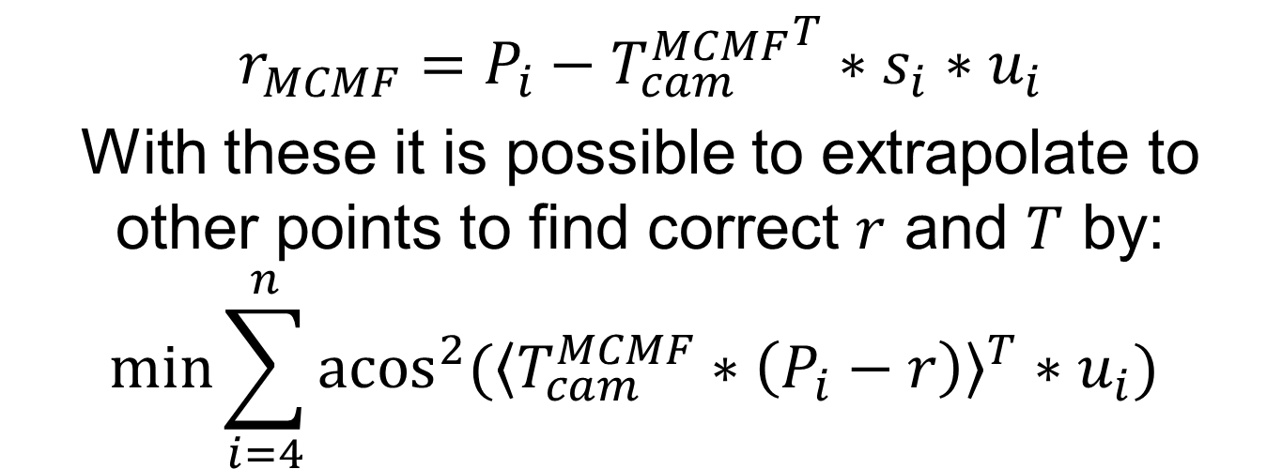
Grunert’s Method
$$r_{MCMF}=P_{i}−{T_{cam}^{MCMF}}^{T}∗s_{i}∗u_{i}$$
With these it is possible to extrapolate to other points to find correct $r$ and $T$ by:
$$\min{\sum_{i=4}^{n}{{acos}^{2}⁡({\left\langle T_{cam}^{MCMF}∗\left(P_{i}−r\right)\right\rangle }^{T}∗u_{i}) }}$$

Slide 19
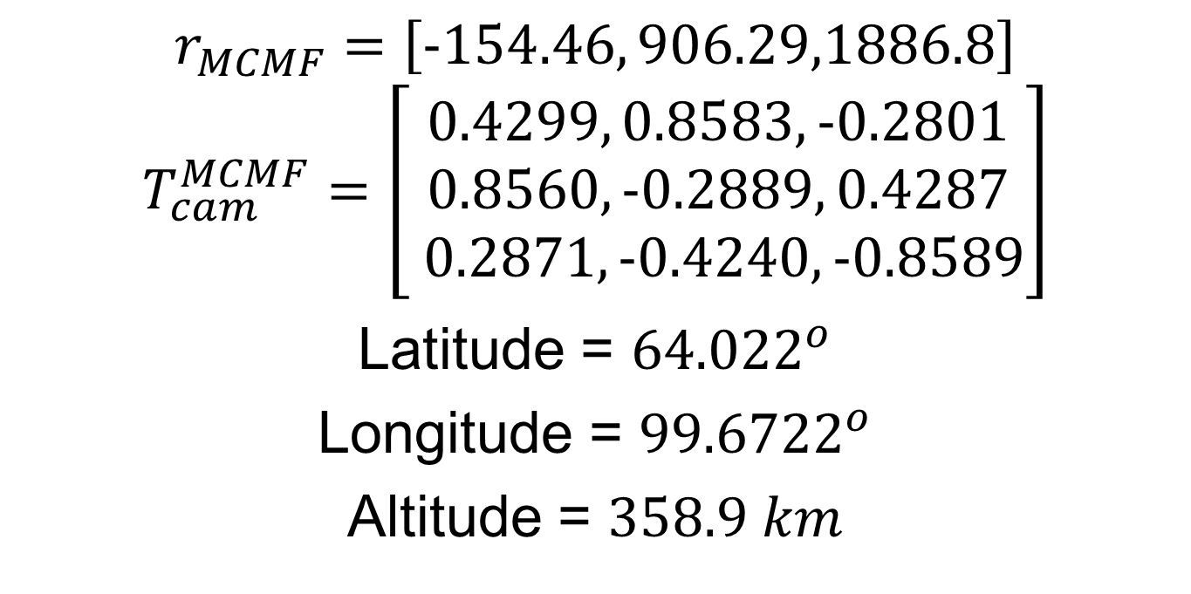
Result
$$r_{MCMF}=\left[-154.46, 906.29,1886.8\right]$$
$$T_{cam}^{MCMF}=\left[\begin{aligned}0.4299, 0.8583,-0.2801 \\ 0.8560, -0.2889, 0.4287 \\ 0.2871, -0.4240, -0.8589\end{aligned}\right]$$
Latitude = ${64.022}^{o}$
Longitude = ${99.6722}^{o}$
Altitude = $358.9 km$

Slide 20
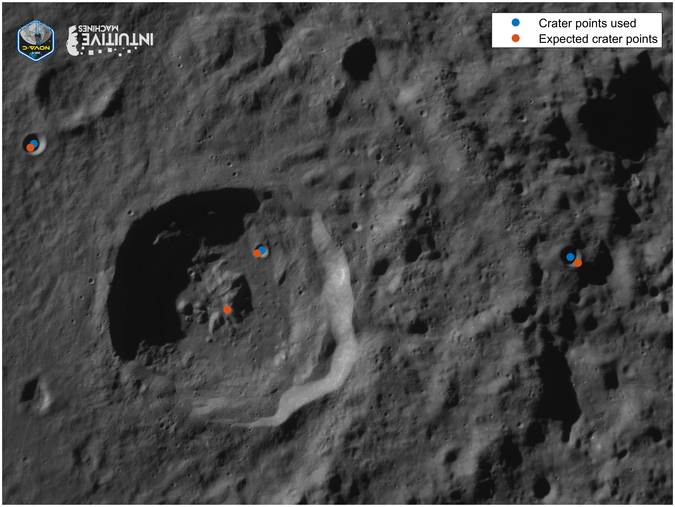
Results
Reprojected crater centers seen on image

Slide 21
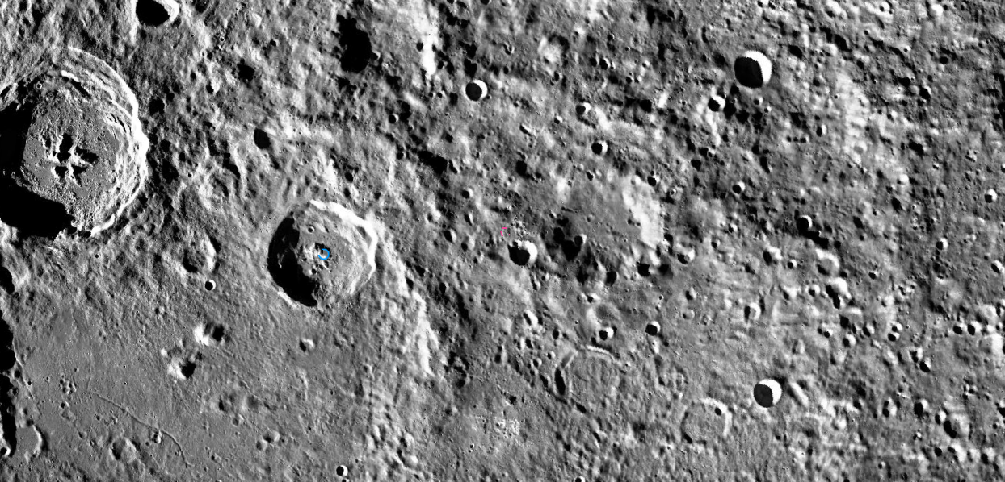
Results
This image shows rough approximation of what camera would see
FOV, orientation are incorrect

Slide 22
Bibliography
Bolles, D. (2020). Terrain relative navigation: Landing between the hazards. NASA Science.
Robbins, S. J. (2019). A new global database of lunar impact craters> 1–2 km: 1. Crater locations and sizes, comparisons with published databases, and global analysis. Journal of Geophysical Research: Planets, 124(4), 871-892.
Shi, Jingnan. Jingnan Shi, jingnanshi.com/blog/pnp_minimal.html. Accessed 24 Apr. 2024.

Slide 23
Questions?

